Slide 1

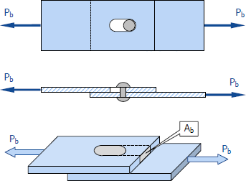
3. Bearing Stress
Bearing stress is the contact pressure between the separate bodies. It differs from compressive stress, as it is an internal stress caused by compressive forces.
Where б_{b} is bearing stress P_{b} is bearing force
A_{b} is bearing area

Slide 2
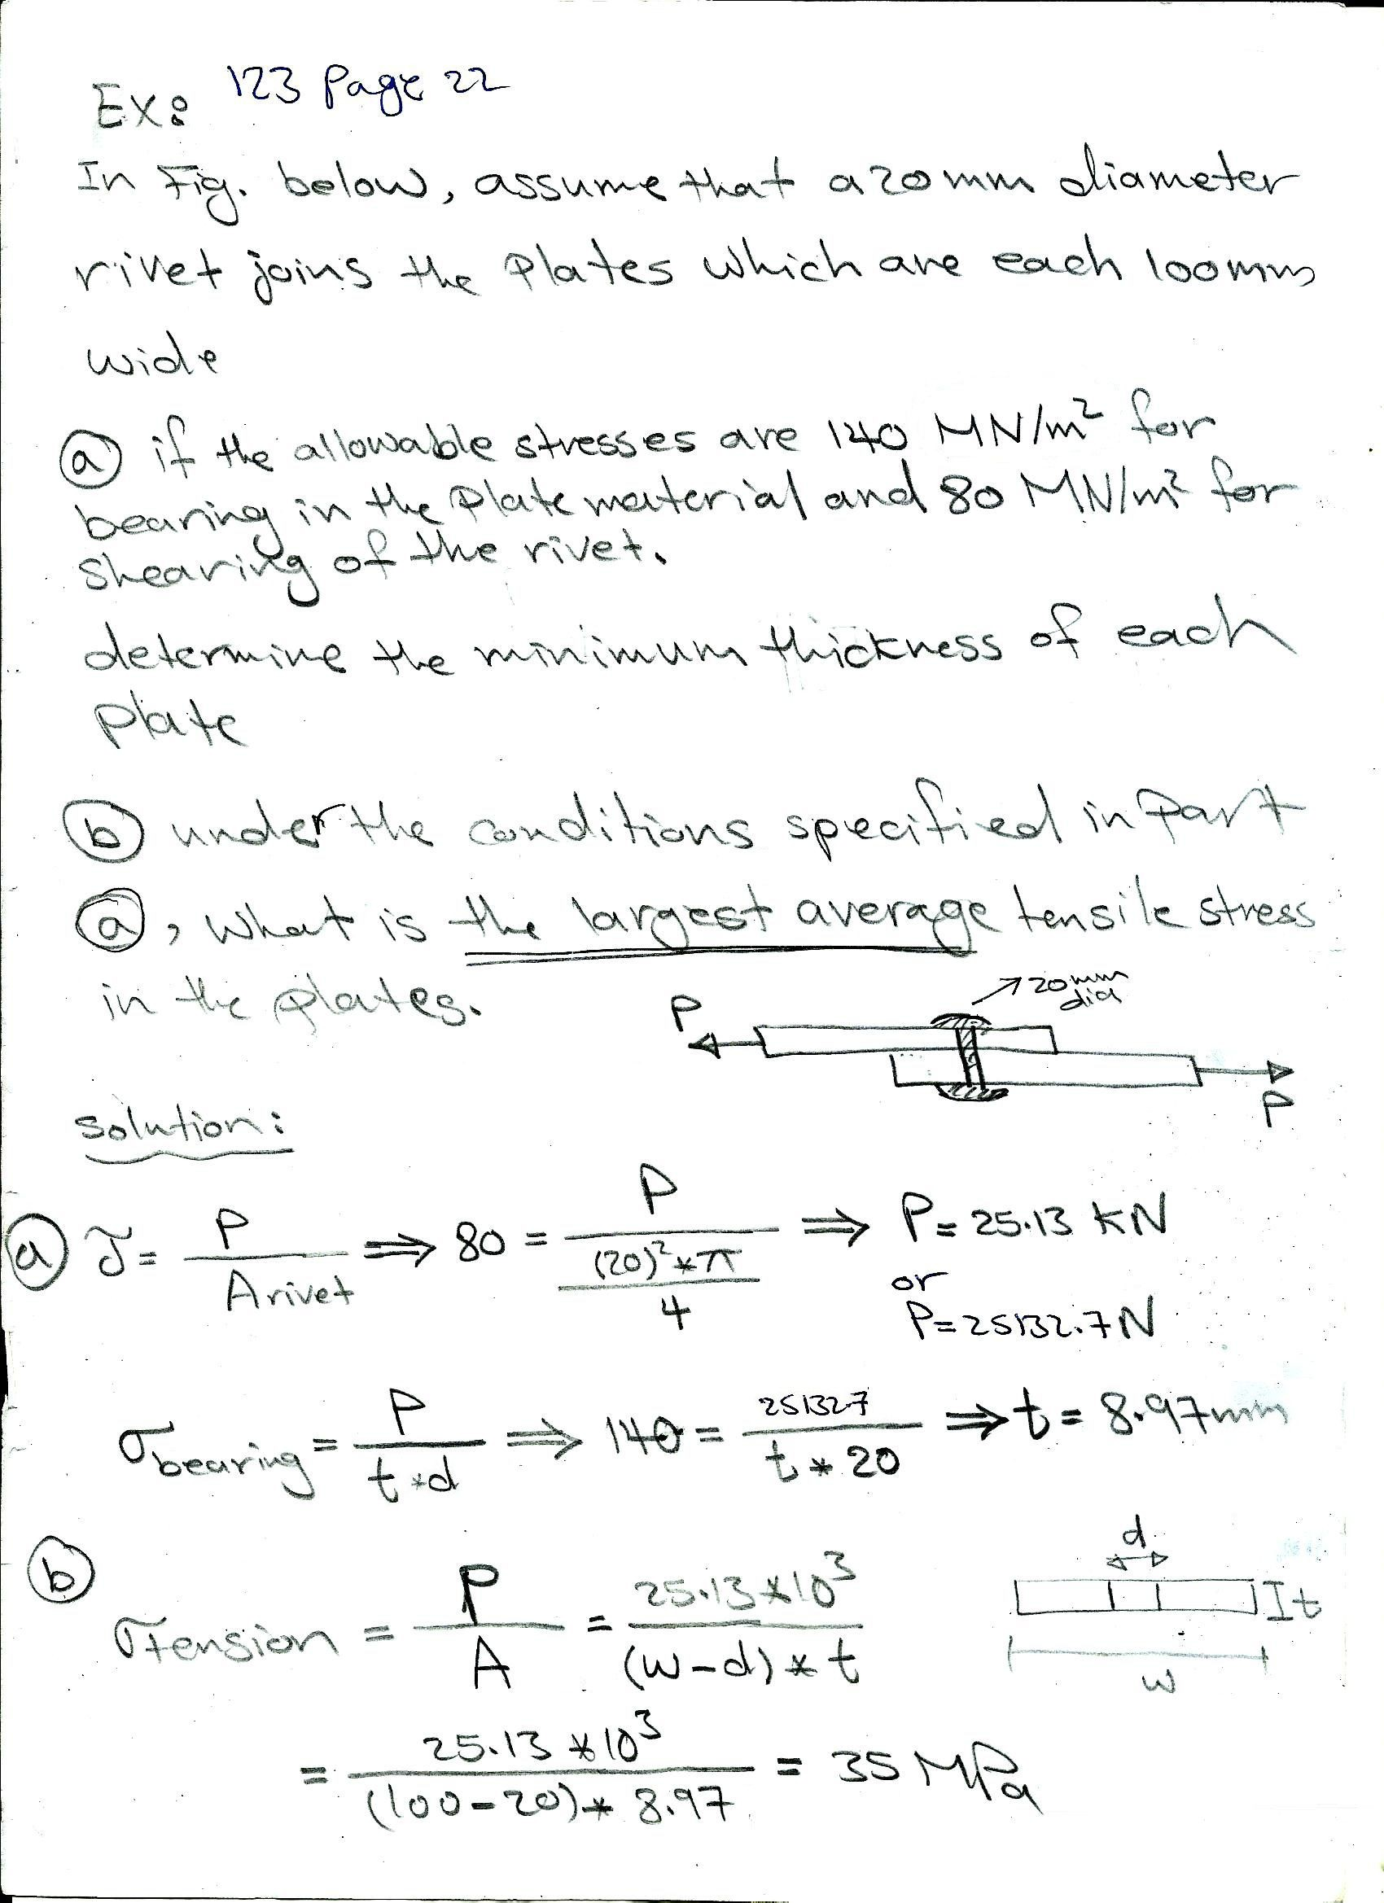

Slide 3
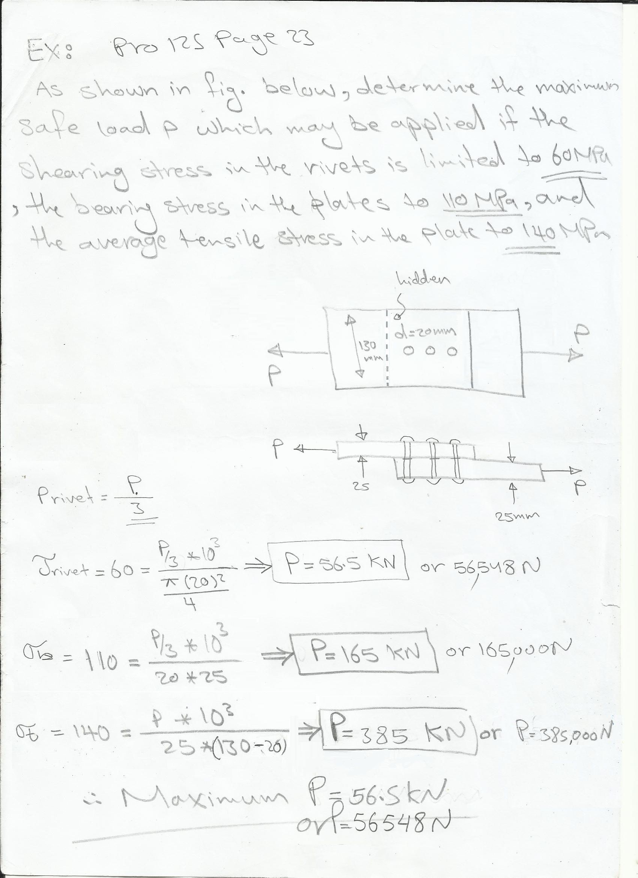

Slide 4
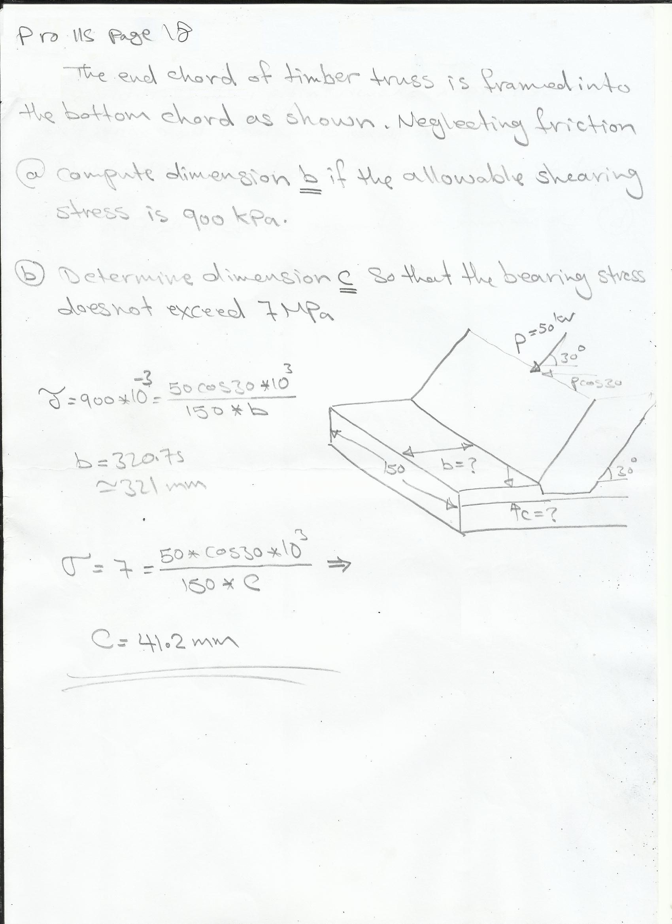

Slide 5
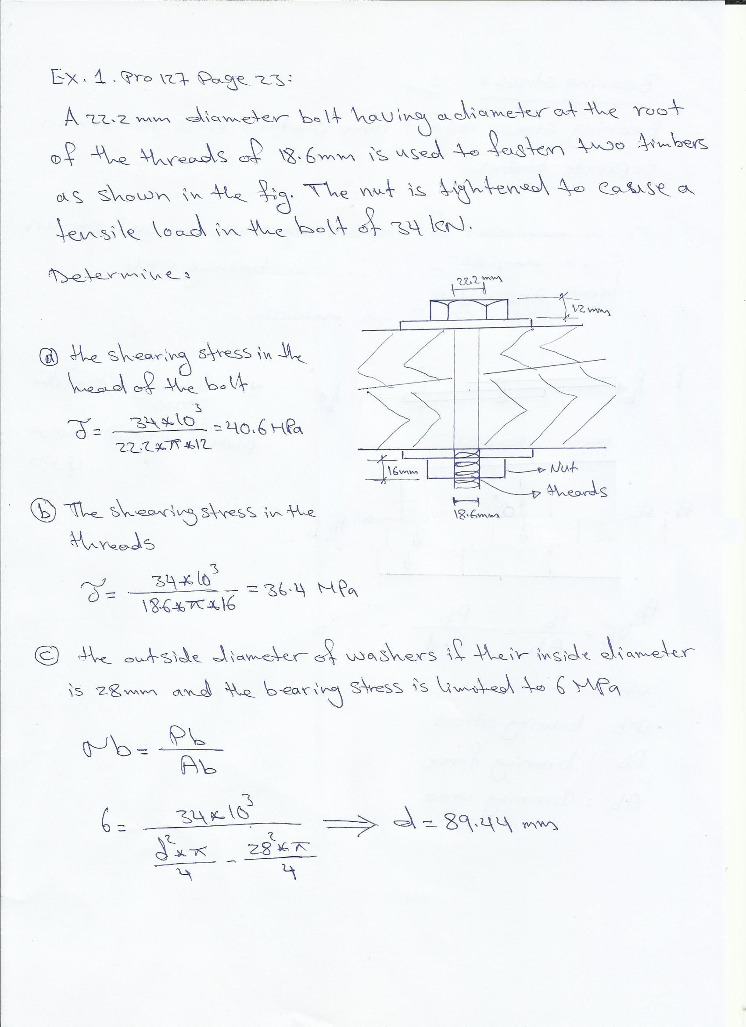

Slide 6
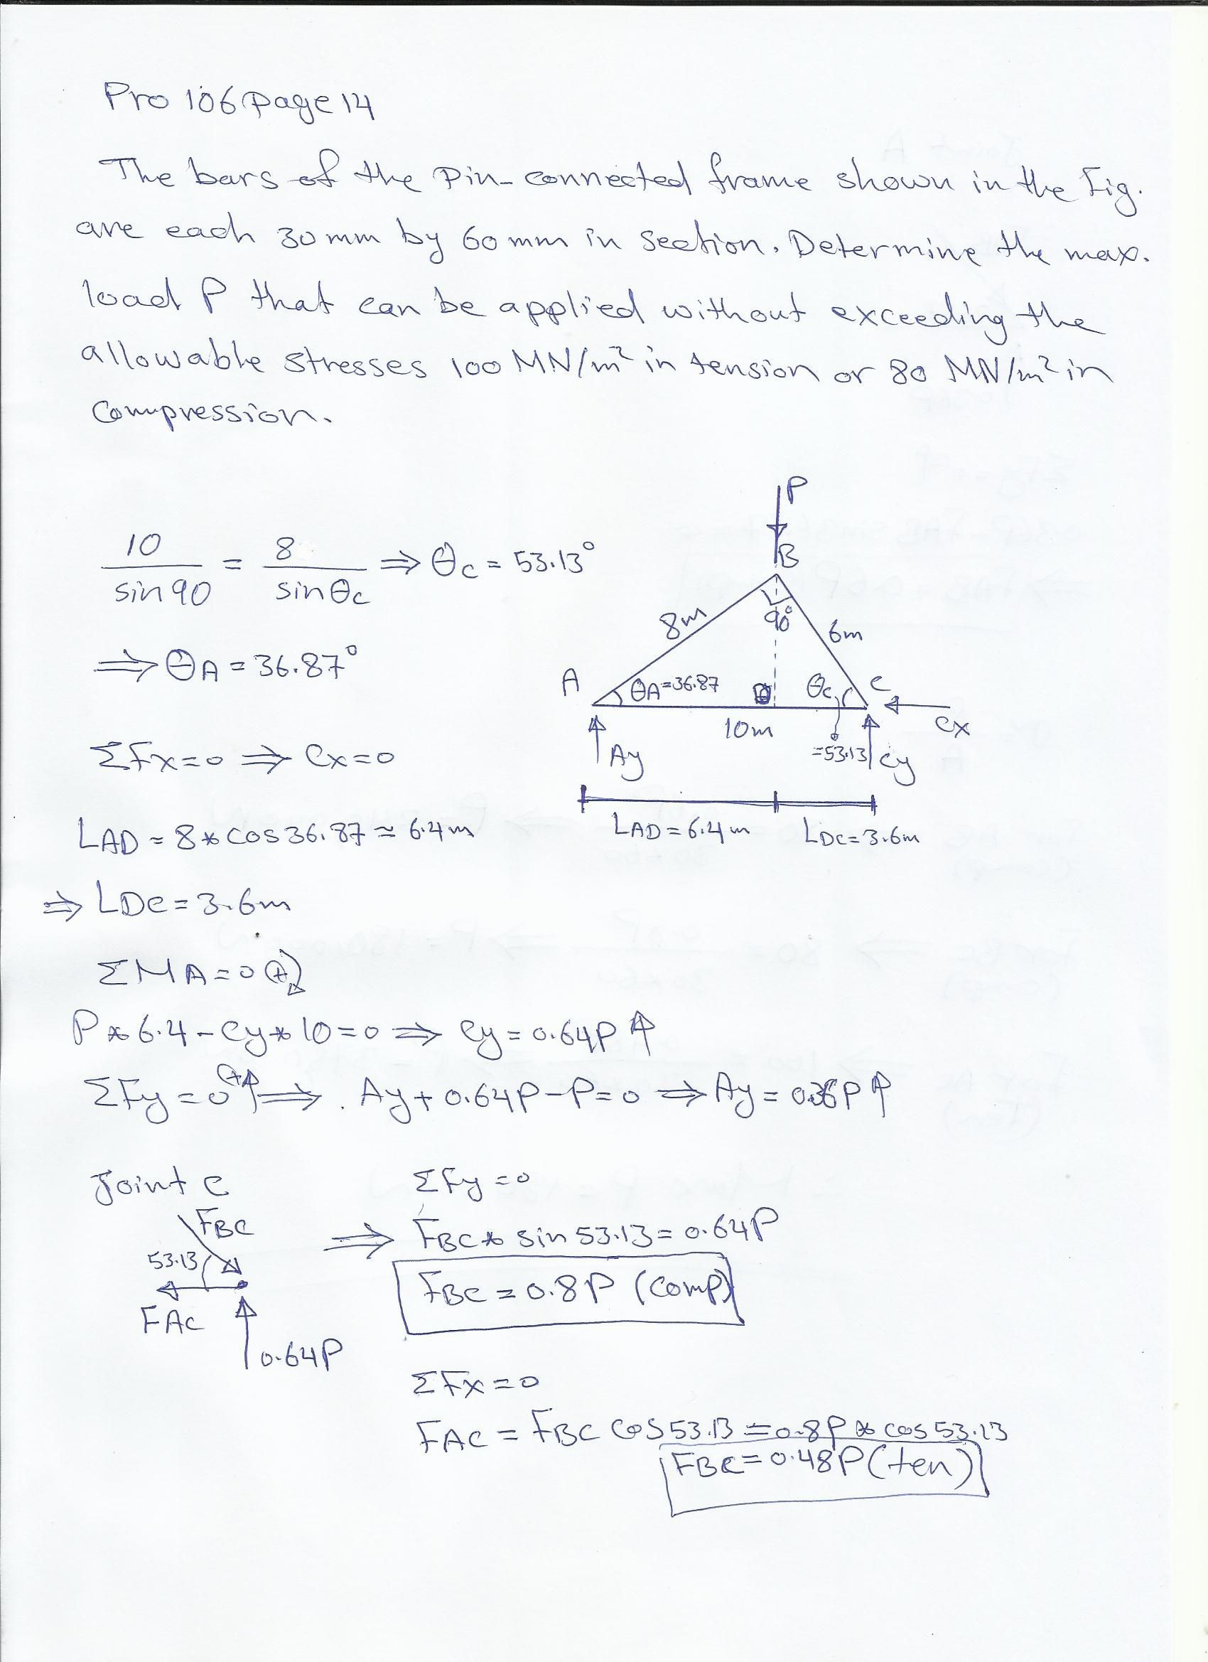

Slide 7
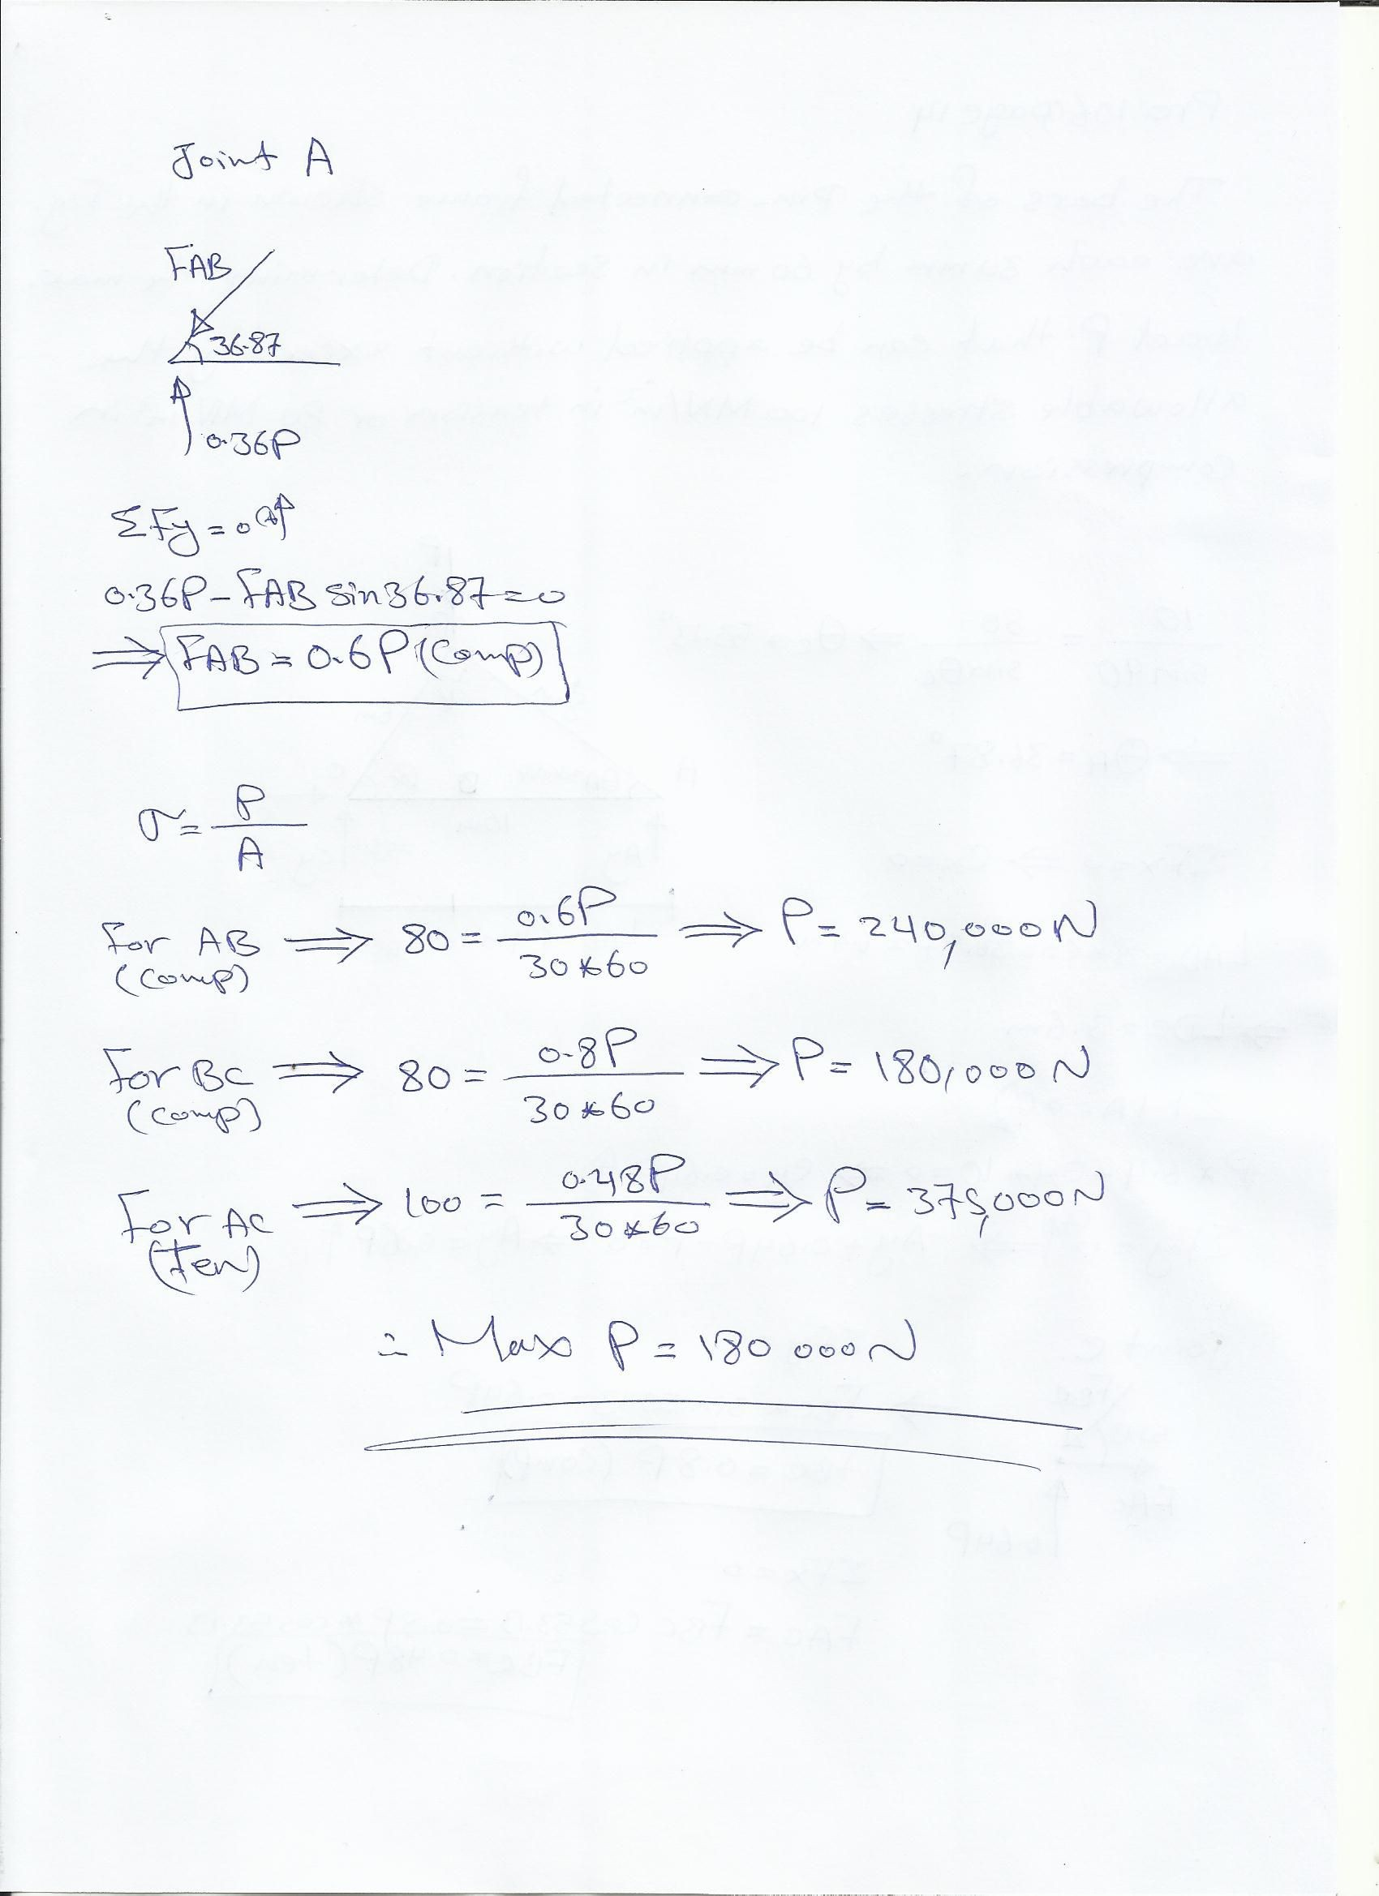

Slide 8
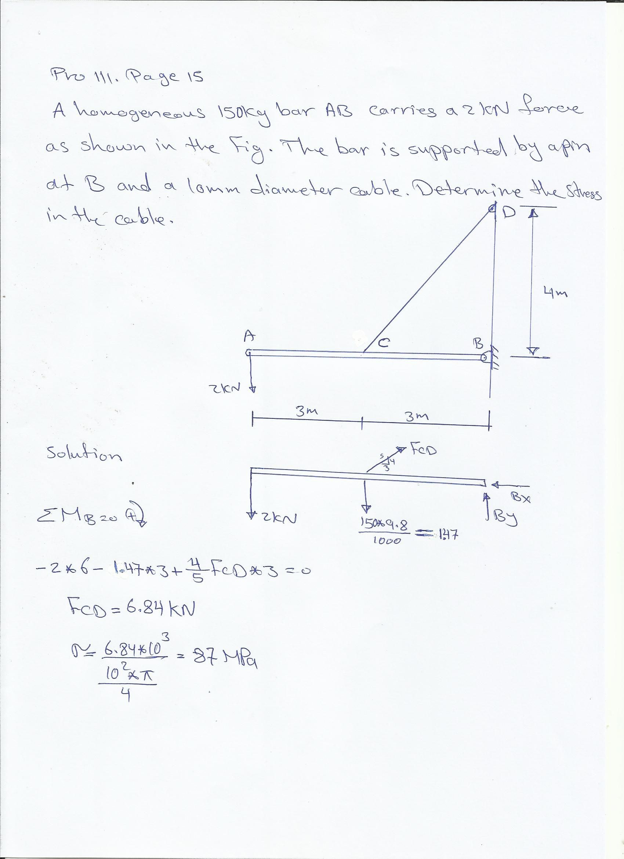

Slide 9
